Slide 1

CHOP R 101: Intro to R for Clinical Data
Introduction
Notes:
Welcome back!

Slide 2



R
Programming language for
data analysis
RStudio
Integrated development environment (IDE)
R Markdown
Computational document format
Notes:
I’m sure you all are excited to get started programming and we will do that in just a few minutes.
Before we do that I want to introduce you to 3 terms that may or may not be new to you.
The first is R. R is a programming language that’s great for doing data analysis. There are lots of things that make R great: it is freely available, makes it easy to wrangling complex data sets, and can produce publication-quality visualizations. There is also an open and welcoming community of folks who use R, which is just as important, if not more important, as the actual underlying details of the language. We are excited to welcome you all to the R community at CHOP and Penn with this workshop.
(**) Then, there’s RStudio. RStudio is the name of a company and also the name of a piece of software this company makes (and makes available for free). You can think of RStudio as a fancy text editor for writing R code. The technical term for a fancy text editor for writing code is “Integrated Development Environment”, or IDE. You can run RStudio on Mac or Windows, or as we will today, on a server that you can access using a web browser.
(**) Finally there’s R Markdown. R Markdown is a computational document format. A computational document is a document that has executable code inside of it, and as we’ll discuss shortly, it’s a great way to perform data analysis in a reproducible fashion. With R Markdown, we will usually write that executable code in R. I say usually because it’s actually possible to write code in python, C++, and other languages inside of an R Markdown document.
So we have R, Rstudio, and R Markdown. For the remainder of this session, I’ll show you how these three R’s come together to form the infrastructure for performing state of the art data analysis.

Slide 3
Getting Started with RStudio
Notes:
Let’s look at Rstudio first.

Slide 4

RStudio: On the Web and In Your Home
RStudio Server
Hosted on a server
(in the cloud)
RStudio Desktop
Installed on your computer
Notes:
There are two versions of RStudio.
RStudio Server – a version of the RStudio IDE that can be accessed from a web browser. It’s hosted on a server that could be on premise or in the cloud. This is what we will use as a training environment today.
RStudio Desktop – a version of the RStudio IDE that is installed on your computer. This is what you should use after the course to continue learning R and working on R projects. On the course website, I posted videos that show you how to install RStudio Desktop on a Mac or Windows computer.

Slide 5
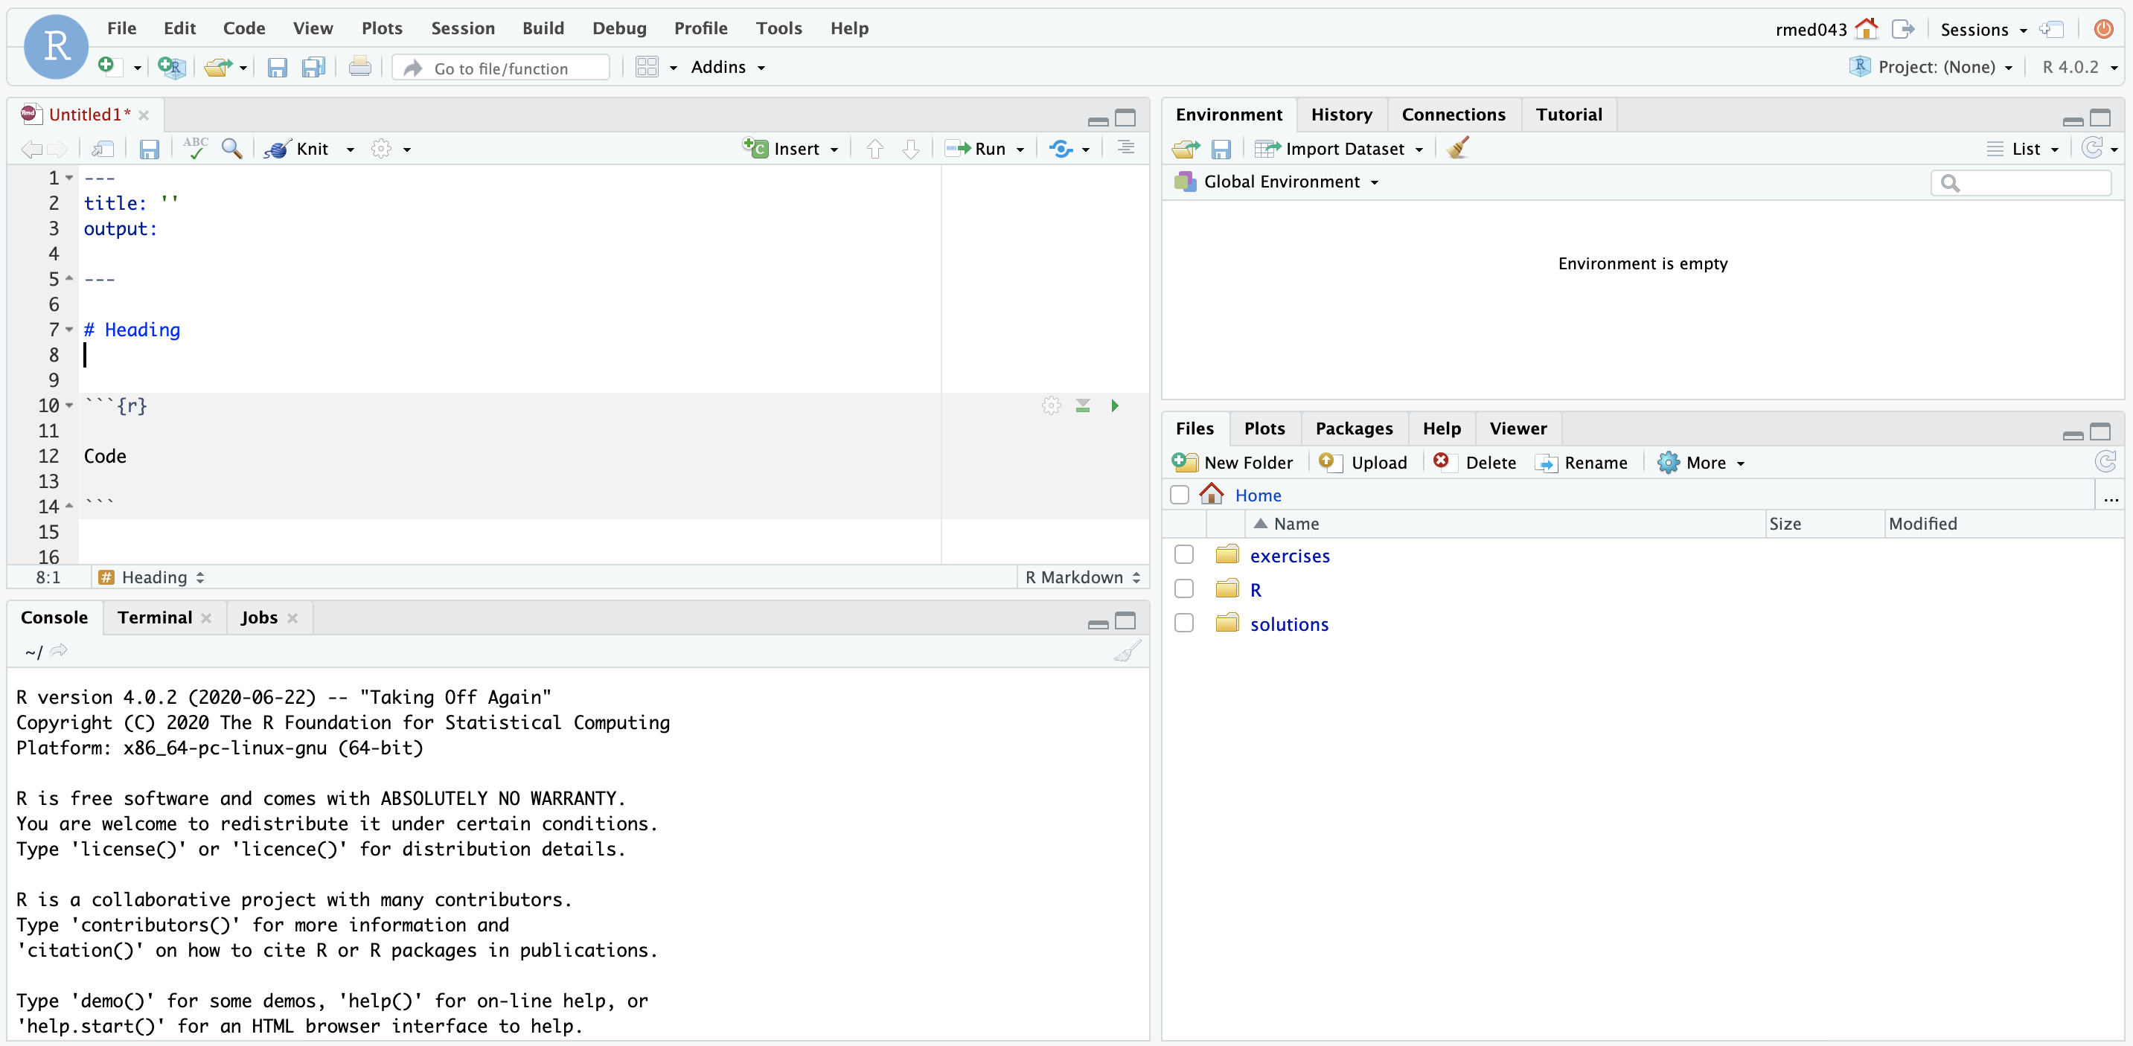
Environment
Editor
Files
Console
Notes:
Here’s what the RStudio window looks like.
On the top left is the ** Editor. This is where you enter code.
On the bottom left is the ** Console. The console allows you to quickly run an individual R command, like for installing a package. We won’t use the console very much in this course.
On the top right is the ** Environment. The environment allows you to look at the data that’s loaded into R’s memory. Interacting with data in the environment tab can be a little bit like working in Excel, and we’ll look at that in an upcoming exercise.
Finally, on the bottom right is where you find your ** Files. We’ll be using an R Markdown files for coding exercises.

Slide 6
Your Turn #1
Click the link in the chat to access the RStudio training environment.
Log in using your username and password.
Click “yes” once you see the RStudio panes.
Notes:
Now it’s your turn to get logged into the RStudio training environment.
The link to the training environment is in this morning's email, but I'm also going to ask Joy to paste the link into the Zoom chat. When you click on this link, it’ll ask you for a username and password. You can find your username and password in an Excel spreadsheet that’s attached to this morning’s reminder email.
Please click the “yes” button in the Participants window to let us know you logged in successfully and can see the Rstudio panes. If you have any issues, please let us know in the chat!

Slide 7
Reproducible Data Analysis and R Markdown
Notes:
Before we jump into coding, I want to talk a little about idea of reproducibility. One of the most powerful aspects of working in the R environment is that it makes it straightforward to produce reproducible data analyses.

Slide 8
18
The Duke Cancer Scandal
Chemo sensitivity from microarrays
Serious errors in data analysis
Clinical trials based on flawed models
Papers retracted, lawsuits settled
Notes:
Consider the following case study.
In the mid-2000s, researchers at Duke University tried to use microarray gene expression data of tumor cells to predict sensitivity to chemotherapeutic agents. This approach generated a lot of excitement at the time, and the resulting work was published in high-profile journals.
(**) Unfortunately, there were a number of serious errors in the data analysis.
(**) Even more unfortunately, patients were enrolled in clinical trials and allocated based on flawed models. It's likely that some patients were actually treated not with the chemo they are most likely to respond to, but with the chemo that's least likely to work.
(**) In the end, 18 papers were retracted, and Duke settled more than 10 lawsuits for an undisclosed amount of money.

Slide 9
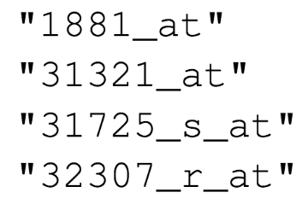
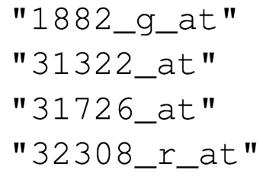

Duke
MD Anderson
Off-by-one indexing error
Notes:
Two biostatisticians at MD Anderson uncovered these mistakes in painstaking work. Let’s look at one of the errors they found.
What you see here are the names of are a few of the hundreds of microarray probe sets – each roughly corresponds to a gene – that the Duke investigators reported tp predict sensitivity to 5-fluorouracil.
(**) And here are the probe sets that the MD Anderson team got. You can see that they're not the same.
(**) If I highlight only the last number of each probe, you might notice a pattern: the number of the probe set that Duke reported is always one less than the number of the probe that MD Anderson found when they re-did the analysis.
(**) This is what’s called a off-by-one indexing error and is what happens when you use a tool like Excel and accidentally miss one row; or you have one dataset that has a header and another one that doesn't. The result is that all the values in the affected column are shifted by one. This is a simple error to make, but it completely invalidates all downstream results.

Slide 10
“Common problems are simple…
Off-by-one indexing error
Sensitive / resistant label reversal
Confounding in experimental design
Inclusion of data from non-reported sources
Wrong figure shown
… and simple problems are common.”
Notes:
The off-by-one indexing error was just one of many simple errors the MD Anderson team discovered.
(**) Another type of error that was pervasive in the study was label reversal so that cell lines were labeled sensitive to a drug when they actually were resistant, and vice versa. That type of error can lead to a scenario where a patient gets the chemotherapy that would be predicted to be least beneficial.
(**) Other problems they identified were confounding, (**) inclusion of data from sources that were not reported in the paper, (**) and wrong figure shown.
These are all simple errors – people who make them aren't necessarily incompetent or negligent. (**) Because these errors are so easy to make and because without good documentation or a reproducible workflow it’s hard to catch them, they are also very common.

Slide 11
Point-and-click is not reproducible
Notes:
A key issue in this case study is that the Duke investigators used “point and click” tools like Excel.
This prevented peers and independent investigators from catching errors in the analysis, until it was too late.
And the Duke case study is only one example where the barrier to reproducibility was that people used graphical user interface “point-and-click” type tools for analyzing large and complicated sets of data. Excel doesn’t record user actions and because of this, is fundamentally not reproducible.

Slide 12
Why YOU should analyze your data reproducibly
“Can we redo the analysis with this month’s data?”
“Why do the data in Table 1 not seem to agree with Figure 2?”
“Why did I decide to omit these six samples from my analysis?”
Your closest collaborator is You from 6 months ago!
Notes:
But reproducibility doesn’t only help others. Consider the following 3 statements and ask yourself if they sound familiar.
-Can we redo the analysis with this month’s data?
-Why do the data in Table 1 not seem to agree with Figure 2?
-Why did I decide to omit these six samples from my analysis?
**Your closest collaborator is you from 6 months ago... but they don’t answer your emails.
On a more serious note: if you are analyzing clinical data and the results might affect patient management or public health, I think you’ll want to know about things that you can do to reduce errors.

Slide 13
Notes:
OK, so that I’ve convinced you that reproducibility is important, how do you do a reproducible analysis? One answer to this is R Markdown.
R Markdown lets you write computer code mixed in with English narrative annotation that documents the purpose of the code and details about the decisions you made in your analysis.
R Markdown is quickly becoming the gold standard for reproducible data analysis. A primary aim of this course is to teach you to use R Markdown and to encourage you to start working it into your day to day data workflows.

Slide 14
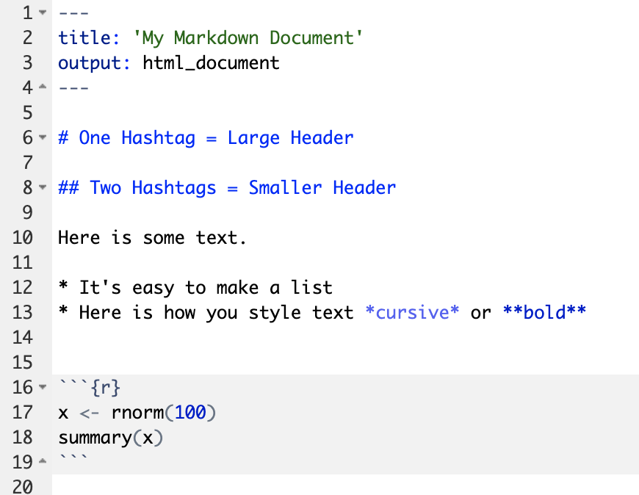
Anatomy of an R Markdown document
Header
Header
Text (with marks)
Code chunk
Notes:
R Markdown documents are composed of 3 basic types building blocks.
**The first is the Header which includes information about the document, such as its title, author, and the desired output format when the document is rendered. A lot of this information is optional so a header can be pretty short, as this one here, or much longer.
**The second type of building block is text. Text can include special kinds of marks that add styling, such as for example hashtags that turn a line of text into a header, and others.
**The third is code chunks. Code chunks contain R code that can be executed to output results.
So how do you execute the code in the code chunks? Basically, there are two ways.

Slide 15
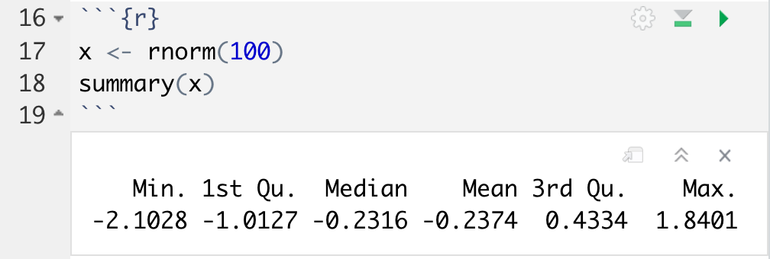
Running a single code chunk
run chunk
Notes:
The first is to run the code in a single code chunk. And you do this by clicking the green right-pointing triangle on the top right of the chunk. I think it’s supposed to look like a “play” symbol.
When you do this ** immediately below the code chunk it will show you the results, in this case some statistics about a normal distribution.

Slide 16
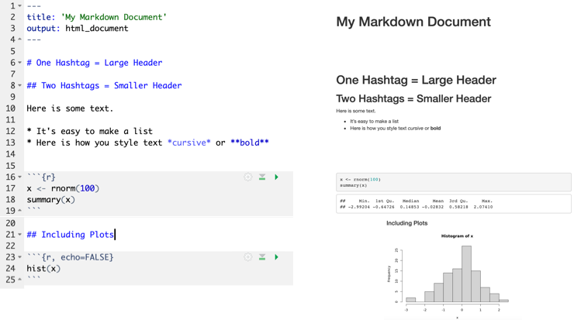
Rendering (“Knitting”) an R Markdown document
Notes:
The second way to execute code is to convert the entire R Markdown document into HTML - or another target format, but for now we’ll stick to HTML because it’s the default and usually what you want. This process of converting R Markdown into a target format is called “rendering” or ”knitting” – the mental model here is that you’re knitting together marked up text, code, and results into a nicely formatted document that you can then present or share with others.
** To knit a document, click the button that says “Knit” next to a blue ball of yarn on the top of the Editor pane.

Slide 17
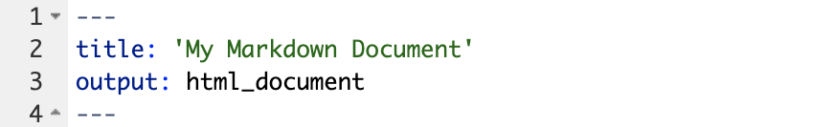
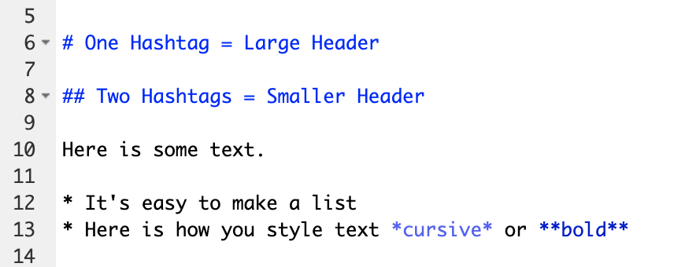
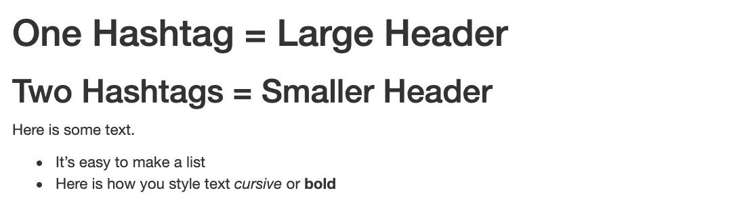
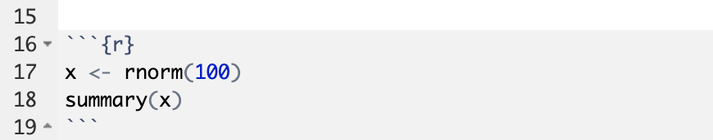
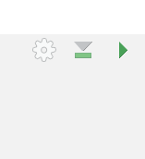
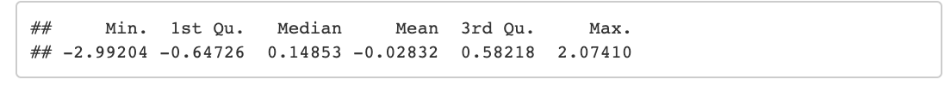
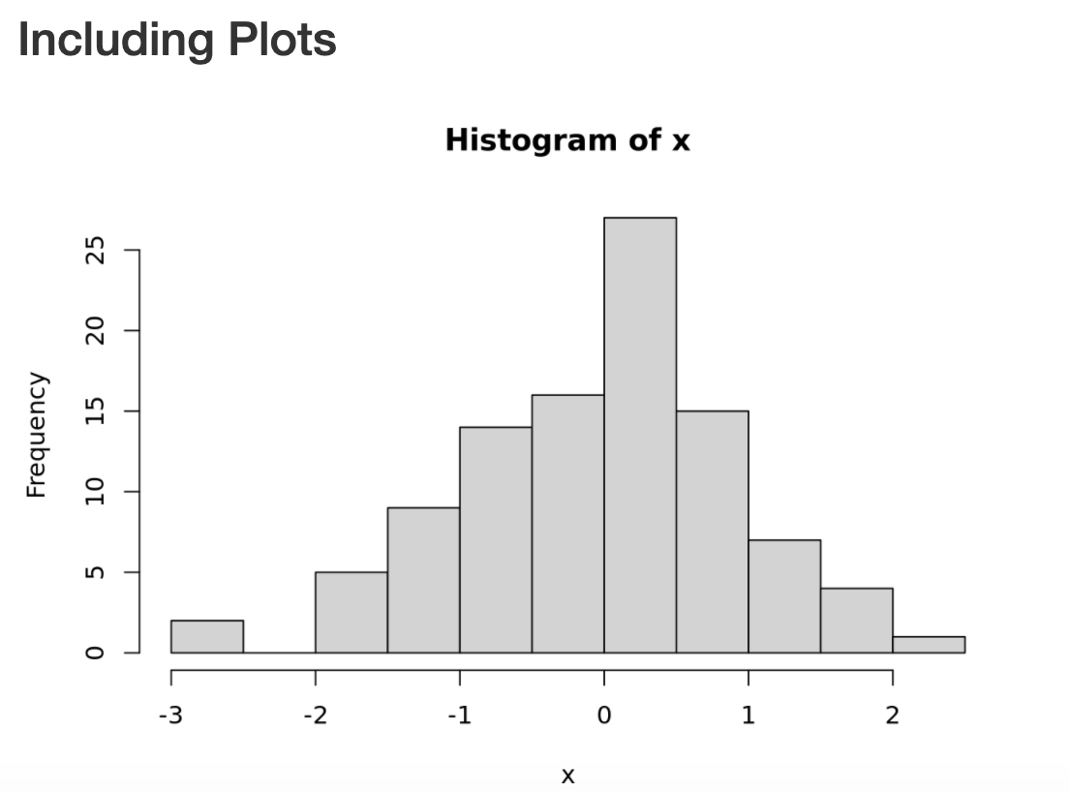
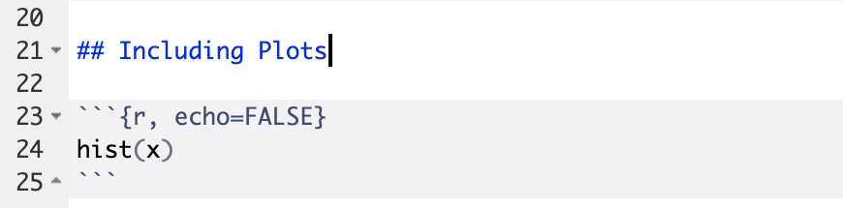
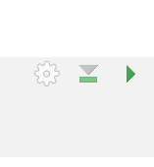
Notes:
Let’s look at this R Markdown document in a little more detail.
Again the first block is the header section. We’re telling R Markdown that the title should be “My Markdown Document” and that when the document is rendered, we want to output to be an “html_document”. That’s the default. You can see that in the resulting HTML document there’s the title “My Markdown Document” in large type letters.
** Here we have some narrative text with marks such as hashtags and asterisks. You can see that having a hashtag at the beginning of a line makes this line a header, and the more hashtags you write, the smaller the header. Also, you can see that, depending on where you write it, with an asterik you can make bulleted lists or text that is italics or bold.
** Then we get to the code chunks. Don’t worry about the contents of the code for now - in brief, this code asks R to generate 100 random values and then print out some summary statistics. The knitted document shows us our code **, tidily placed into a gray box to make it visually distinct from the text; and then immediately after, the results of that code after it was executed.
** Here we have one more code chunk, and what this is showing is that (1) in addition to text output, you can also make R create graphical plots, and (2) you can tweak the behavior of a code chunk – note that this code chunk has a chunk option of echo=FALSE, and this tells R that you don’t want it to repeat, or “echo” the code in the rendered document.
So let’s practice creating an R Markdown document, running a code chunk, and knitting.

Slide 18


Your Turn #2
Go to File > New File > R Markdown. Click OK.
Run each chunk by clicking . Note what happens.
Knit the document ( ). Type test and click Save to save the HTML file. Inspect the HTML document.
Notes:
It’s your turn again.
Follow the instructions in Your Turn #2 to
- create a new R Mardown document
- run all of the code chunks
- knit the document
When you knit the document, it will ask you for a filename to save to – just enter “test”
We will meet back in 3 minutes to review this exercise together.
// Points to make during live coding:
Header starts with 3 dashes, ends with 3 dashes
Code chunk starts with 3 backticks and r in curly braces, ends with 3 backticks. Editor makes code chunks gray.
Note that we saved test.Rmd (R Markdown file) and test.html (knitted HTML file). You might wonder why you want to deal with two files. Rmd is source code document – makes things reproducible, can share with an analyst; HTML is presentation – share with your boss.
Why is the gray code box missing in the rendered document? echo=FALSEs

Slide 19
Importing Data
Notes:
Now that we are familiar with how to create R Markdown documents we can begin the process of performing data analysis in R in earnest by importing a clinical data set.

Slide 20
The Data Analysis Pipeline
From R for Data Science (https://r4ds.had.co.nz/introduction.html)
Notes:
The first step in the data analysis pipeline is to load or ** import the data into your environment, which for the purposes of this course is R.
In today’s workshop we will be using a de-identified data set consisting of COVID-19 laboratory test results from CHOP’s infectious disease diagnostics lab (IDDL). This data is stored as a CSV file.

Slide 21

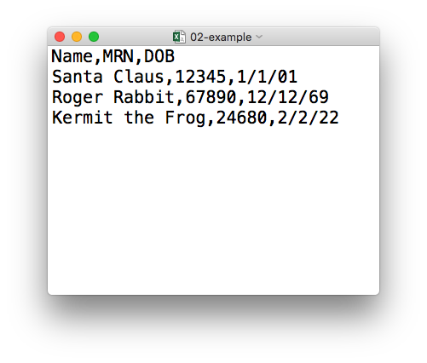
plain text (“flat”) file
csv
rectangular structure
header row
Notes:
So what’s a CSV file? CSV stands for comma-separated values.
** A CSV file is a plain text file, which means you can open it in a text editor and look at it.
Here we have a CSV file with the names, medical record numbers, and dates of birth for three fictional “patients”
** This data structure is called rectangular because it falls into rows and columns, where each row has the same # of columns, and each columns has the same # of rows.
** Also note that this particular CSV file has a header row that instead of data, has a descriptor of what kinds of data are found in each column. CSV files often but not always have such a header row.

Slide 22
Tidyverse: R Packages for Data Science
A consistent way to organize data
Human readable, concise, consistent code
Build pipelines from atomic data analysis steps
Notes:
To import our CSV data, we need some additional data analysis tools. In this course, we will be leveraging the Tidyverse.
The Tidyverse is a set of tools that has become the de facto standard for doing data science with R.
The basic tenets of “tidy” data analysis include:
Data should be organized in a consistent, standardized way. Each row is an observation, and each column is a variable. This is a very common way to organize data in a spreadsheet and might sound familiar from how you may already organize data in tools like Excel.
Programming code that acts on the data should be consistent, concise, and sound like human language as much as possible.
Each data analysis can be broken down into a series of atomic steps, such as “select this column” or ”arrange the data by the values in that column”. An arbitrarily complex data analysis can be broken down as a pipeline of atomic steps.

Slide 23
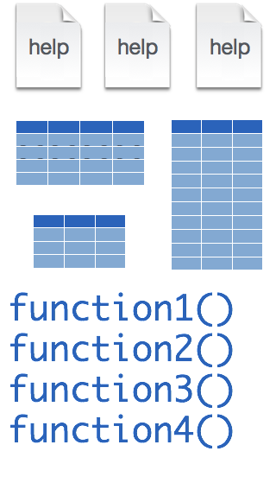
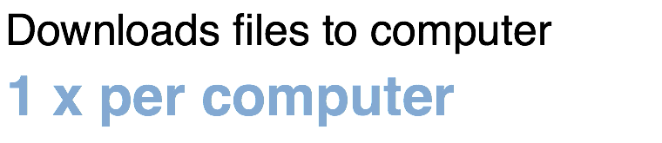
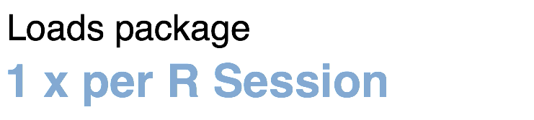
Installing and loading R packages
tidyverse
install.packages("tidyverse")
library("tidyverse")
Notes:
The Tidyverse is package (a collection of functions, data, and help documentation) that we can use to extend the functionality of R.
You can download and install a package with the command ** install.packages. So let’s say you want to install a package named “tidyverse”. You would go to the R Console and type install.packages(“tidyverse”). Each package you want to use needs to be installed only once on each computer. On our RStudio Server, you won’t need to install any packages for this course (I have installed them for you). But when you go on to use R in the future, you will have to install packages.
After you’ve installed the package, in order to use the functions that it provides, you also need to load the package into the computer’s memory. This is done with the command ** “library”. So to enable all the functions in the “tidyverse” package, you type library(“tidyverse”). Packages remain loaded until you quit or restart the R program. So every time you start a new R session you have to load each package that you want to use again.
So these are the first two R commands we’ve covered - install.packages and library.
One of the great things about R is that there are tens of thousands of packages,
** and virtually all of them are free to download and use, including all the packages I’m introducing in this course.

Slide 24

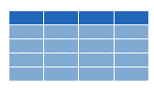
read_csv()
data_frame <- read_csv(file_name)
csv
Notes:
We can import CSV files using the read_csv() function.
Here is how you use the read_csv function to read a CSV file into a data frame object. A data frame is a type of object that works like a spreadsheet.
You start with the name of the object then you have this left-ward arrow looking symbol then read_csv and then the file name in parentheses.

Slide 25
function
(does stuff)
data_frame <- read_csv(file_name)
Notes:
This code construct is exceedingly common in R, so I want to spend a few minutes exploring it together
read_csv() is a ** function. Remember that functions are defined in packages. We loaded the Tidyverse package to be able to use the read_csv function.
You may be familiar with functions from math class or perhaps also from Excel. A function takes an input, say an ‘x’ value and returns an output, say a ’y’ value. Functions in computer programming also take inputs and return outputs. But the inputs and outputs here are the objects that exist within the context of a programming language.
For read_csv, the input is the file name of a CSV file; and the output is a data frame with the contents of the file.

Slide 26
function
(does stuff)
argument
(input)
data_frame <- read_csv(file_name)
Notes:
The input that goes into a function is called an argument. The argument to a function gets put in parentheses.
A function can have zero, one, or many arguments. If there is more than one argument, we use commas to separate them. We’ll see examples of that later.

Slide 27
object
(stores output)
function
(does stuff)
argument
(input)
data_frame <- read_csv(file_name)
Notes:
The output of the read_csv function is a data frame object. You will usually want to *capture* that data frame inside of a named object so you can use it as the input for other functions, for example to summarize or visualize your data.

Slide 28
object
(stores output)
function
(does stuff)
argument
(input)
data_frame <- read_csv(file_name)
assignment operator
(“gets”)
Notes:
To put the output of the read_csv function into a named object, we use the assignment operator.
The assignment operator is a smaller-than followed by a dash and looks kind of like an arrow pointing left. It’s usually pronounces “gets.” So this line of code reads: data_frame gets read_csv of file_name.

Slide 29
read_csv()
data frame to read data into
name of
CSV file
covid_testing <- read_csv("covid_testing.csv")
covid_testing
covid_testing.csv
csv
Notes:
Let’s put these pieces together to load our covid data set.
This line of code reads the “covid_testing gets read_csv of covid_testing.csv”.
You might notice that one of the objects is put in quotes and the other one isn't.
To be honest, quotes in R can be super confusing. A couple of rules are: names of objects such as data frames don't get quotes. On the other hand, literal file names are always put in quotes. Sometimes, either quoting or not quoting works. This is one of the things where you will get a good sense but not until after some trial and error.

Slide 30

Your Turn #3
In the Files pane, click on the folder exercises. Open the R Markdown file titled 01 – Introduction.Rmd Instructions for this exercise are in the text of the R Markdown document. Click when you are done.
Notes:
// Points to make during live coding
- Running a code chunk is useful for interactive work.
- Environment pane shows you an inventory of all the named objects you’ve created.

Slide 31
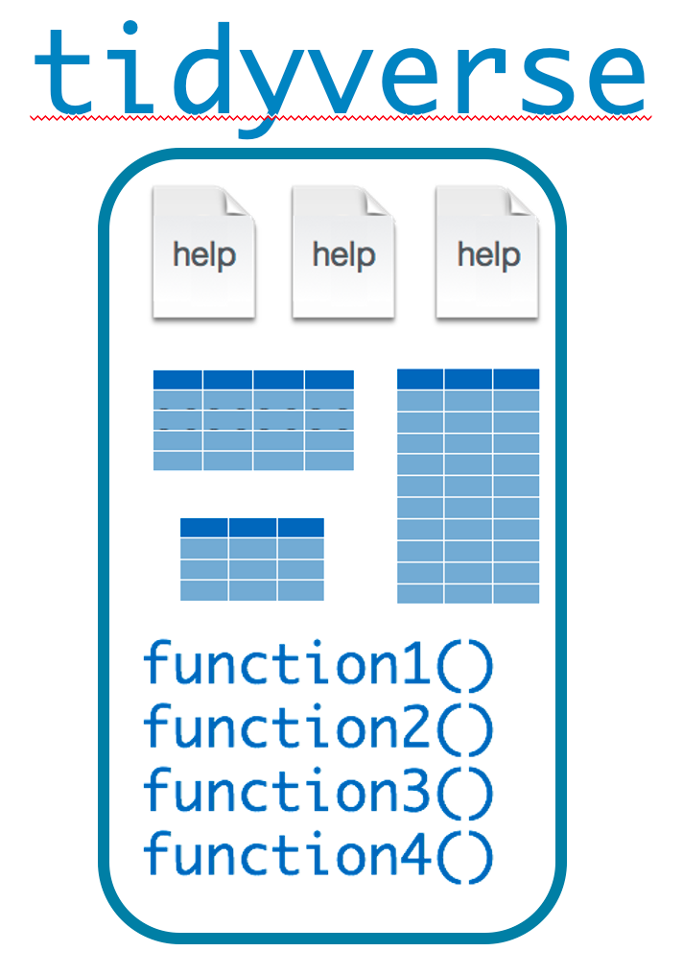

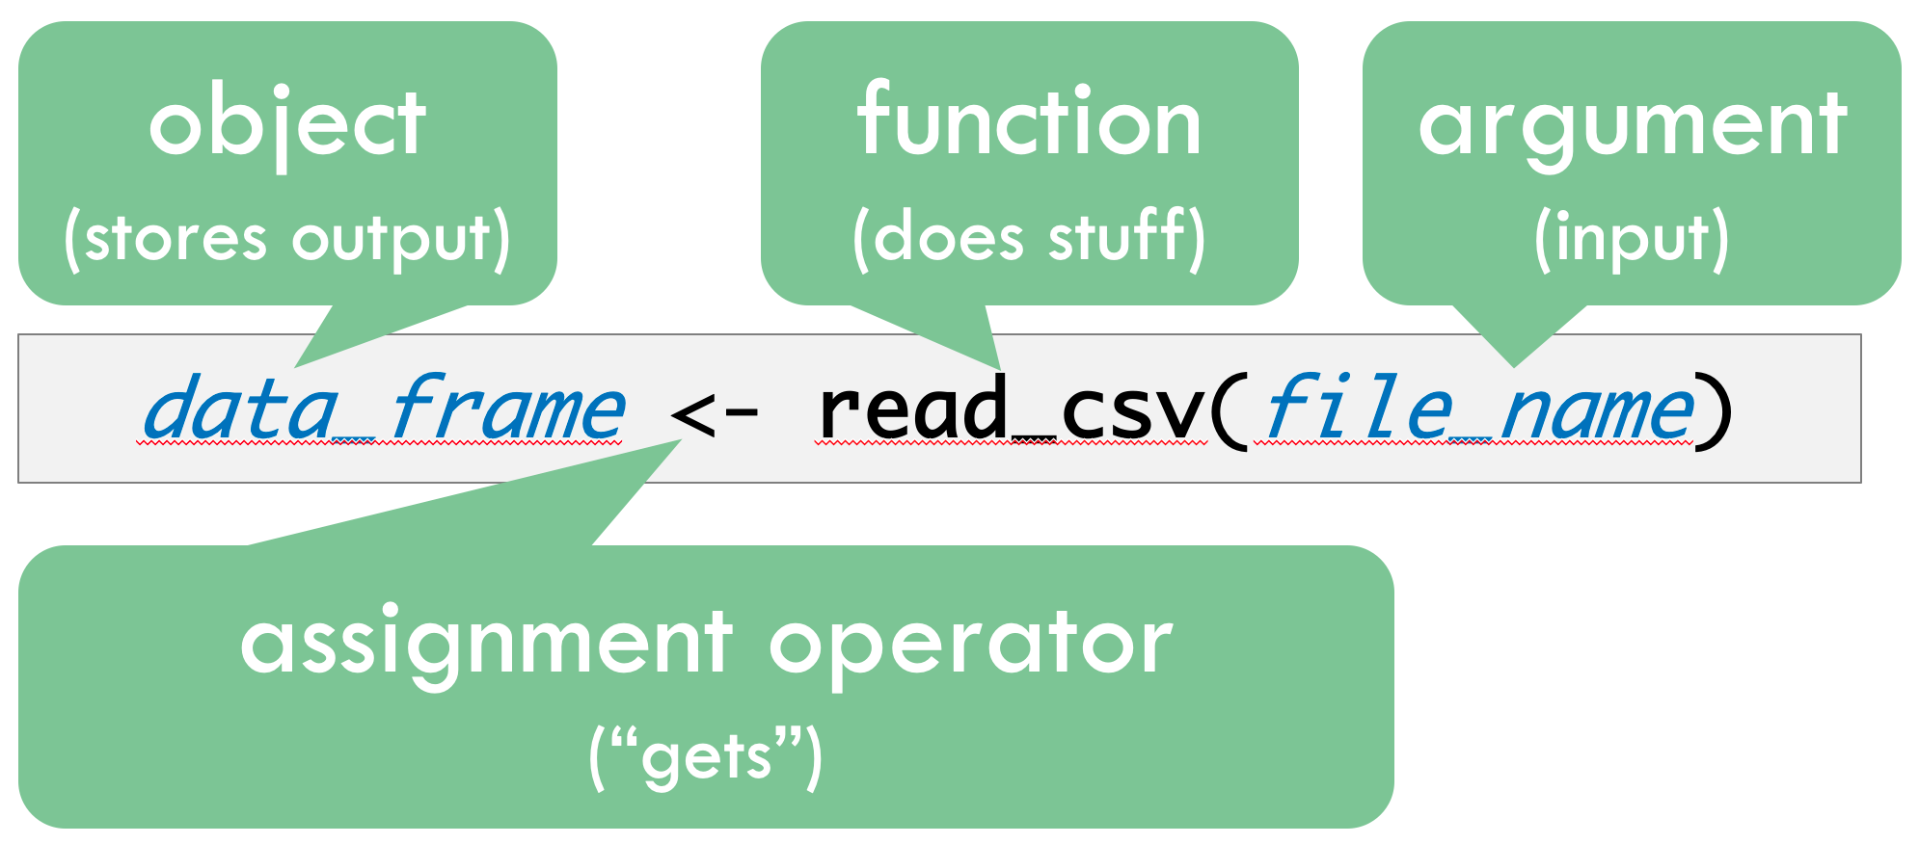
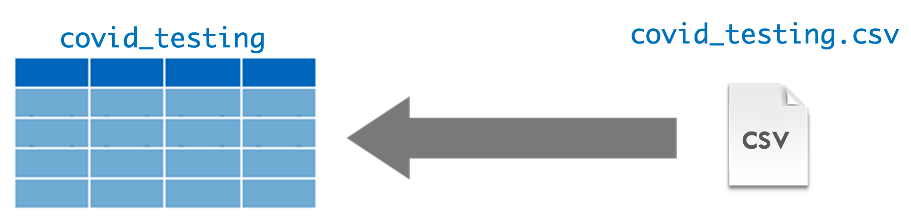
Recap
Programming Language
IDE
(Editor)
Document Format
Packages extend the functionality of R. Install with install.packages() and load with library().
Functions do stuff. They accept Arguments as input and return an Output. Capture an output in an Object using the assignment operator ( <- ).
Importing Data is the first step of data analysis. Use read_csv() from the tidyverse package to import data stored in a CSV file.
Notes:
To recap what we have covered in this session--
We started by defining and differentiating ** R (the programming language) from ** RStudio (the integrated development environment or editor) and ** R Markdown (the document format we use for reproducible data analysis). Then we explored RStudio and R Markdown.
We then looked at how ** packages...
** Functions…
** Importing data...

Slide 32
What else?
Notes:
At the end of each session I’m including a “what else” section to introduce you to ”what else” there is out there for your to explore and learn about after completing this course.

Slide 33
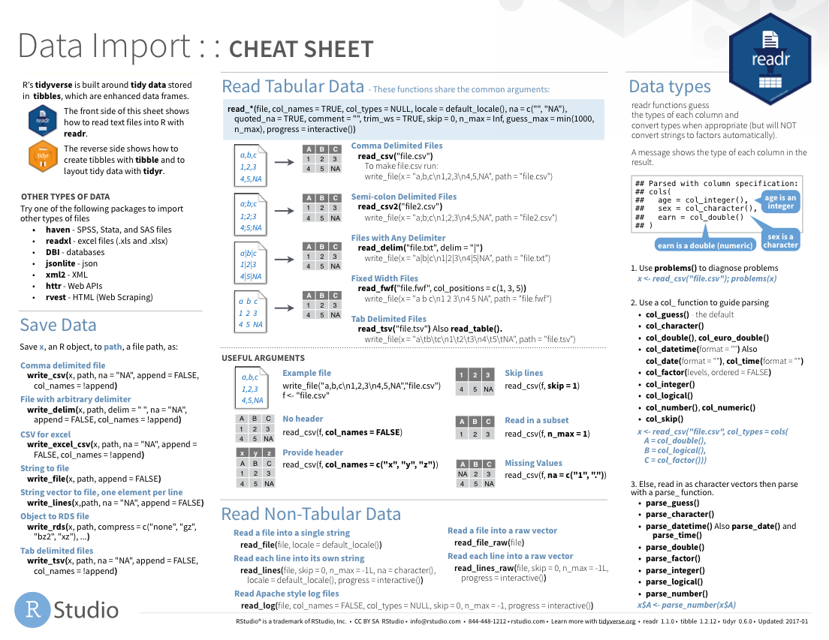
https://rstudio.com/resources/cheatsheets/
Notes:
RStudio the company publishes a number of cheat sheets which come in handy for data analysis.
Relevant to this session, the Data Import cheat sheet helps with importing data from file types similar to CSV but with other delimiters.
I’ve linked the current Data Import cheat sheet on the course website.

Slide 34
Notes:
Not all data is in CSV files, and fortunately R supports a huge number of other file formats, and here are some of the packages that help import or export them:
Readxl: Excel
Haven: SPSS, Stat, and SAS files
Googlesheets
Rvest: scrape the web
Jsonlite: JSON data and APIs on the web

Slide 35



















Databases
https://db.rstudio.com/databases/
Notes:
You can also connect to a large number of databases directly in R to pull your data. For example, CHOP uses Netezza for the Clinical Data Warehouse, Oracle for Epic Clarity, and REDcap for a large number of research projects, all of which have R interfaces.

Slide 36





Notes:
In addition to HTML, R Markdown documents can be “knitted” into a number of additional formats including PDF, Microsoft Word, PowerPoint, and even interactive dashboards. We will look at dashboards in some detail in the last session.

Slide 37
R Interface to Python
```{python}
import pandas
covid_testing.info()
```
Notes:
Finally, I wanted to mention again that in addition to R, R Markdown supports many other programming languages, including Python.
So you can mix code chunks written in R with code chunks written in Python, and here on the side is an example of what a python code chunk would look like.

